Slide 1
Key issue 2
WHY IS EACH POINT ON EARTH UNIQUE?

Slide 2
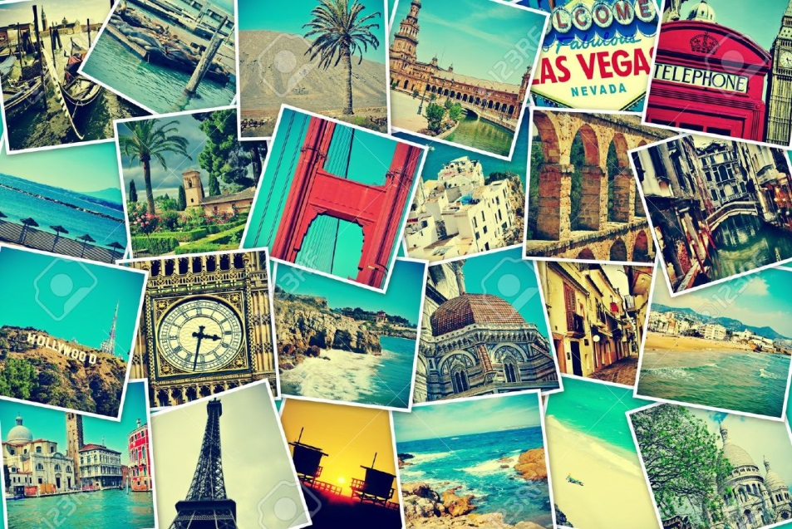
PLACE
A PLACE is a specific point on Earth, distinguished by a particular characteristic(s).

Slide 3
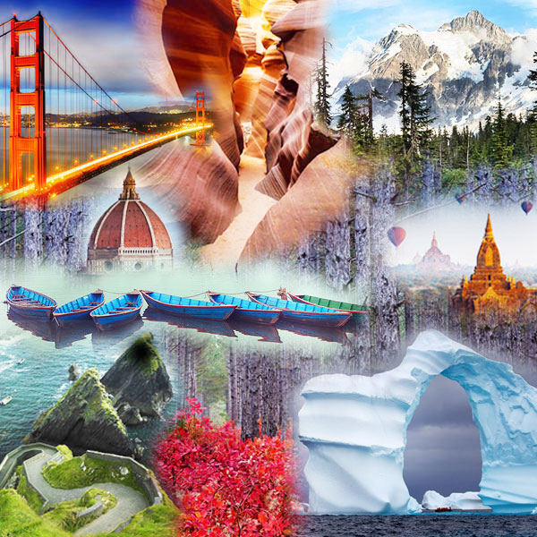
Describing the features of a place helps to explain similarities, differences, and changes occurring between different locales.

Slide 4
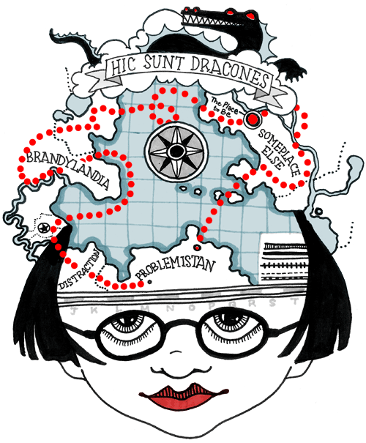
Every person holds a unique SENSE OF PLACE- a strong sense of identity and character that derives from our surroundings.
We are all the product of where we come from.

Slide 5
Your SENSE OF PLACE impacts many aspects of your life and personality, including:
Behavioral Culture (how you act, what you believe)
Material Culture (what you want)
Expectations (i.e. time)
Comforts & Stressors
Understandings of other places

Slide 6
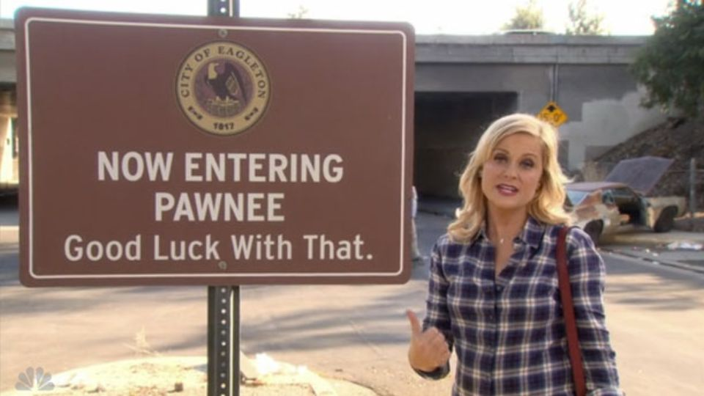

Slide 7
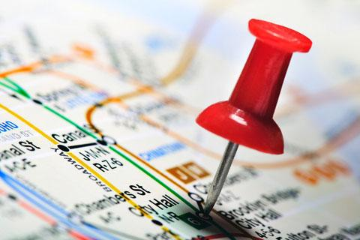
A PLACE on Earth is identified by its LOCATION, the position that it occupies on Earth’s surface.

Slide 8
LOCATION can be identified in three ways:
Place Name
Site
Situation

Slide 9
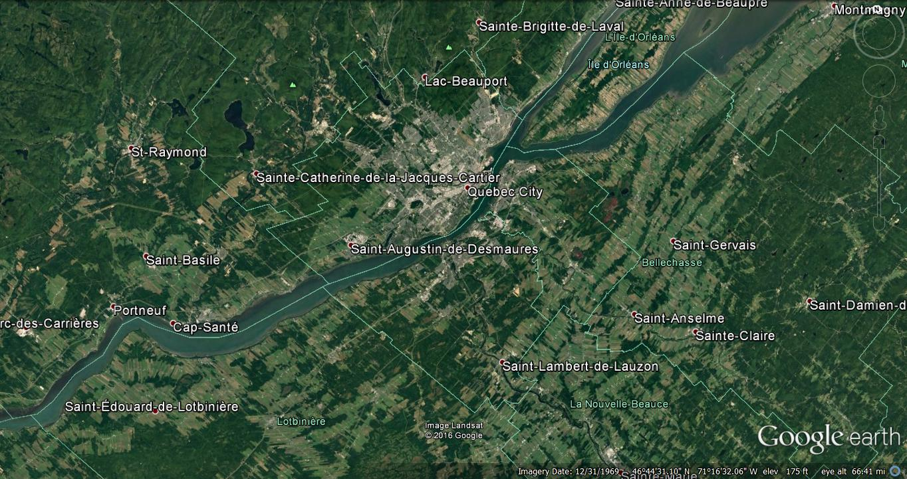
LOCATION: PLACE NAMES
A TOPONYM is the name given to a place on Earth.
Notes:
Situation is most important for finding an unfamiliar place and for understanding a place’s importance, or, in other words, connection to other places, such as Interstate highways or rivers.

Slide 10
Toponyms often derive from:
Names of founders
Religious connections
Local physical features
Colonial origins

Slide 11
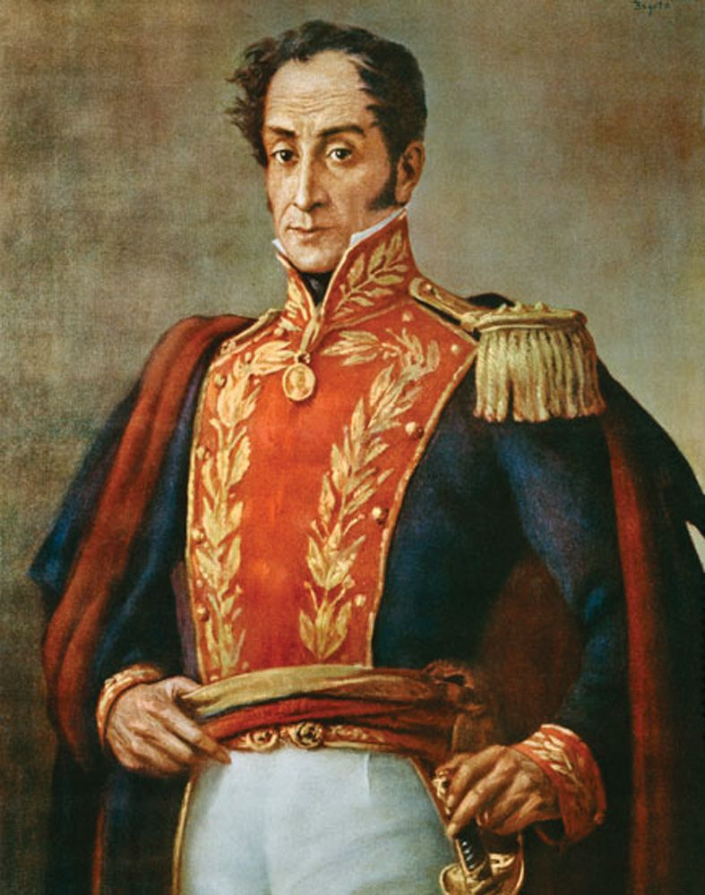
Bolivia named for Simon Bolivar (founder/influential citizen)

Slide 12
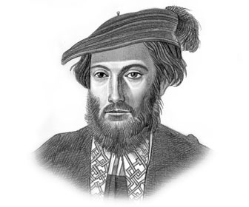
‘Merica named for ‘Merigo Vespucci (Discoverer)

Slide 13
Sao Paolo, Brazil, 11m inhabitants– (religious influence)

Slide 14
St. Paul, MN – about 300k inhabitants – (religious influence)

Slide 15
Bethlehem, PA (religious influence)

Slide 16
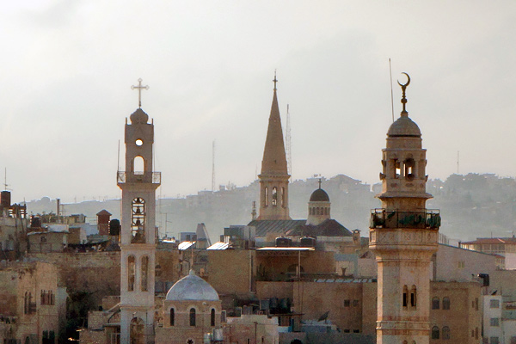
Bethlehem, Palestine ‘house of meat’ in Arabic - bayt laHm (SOCIAL characteristic)

Slide 17
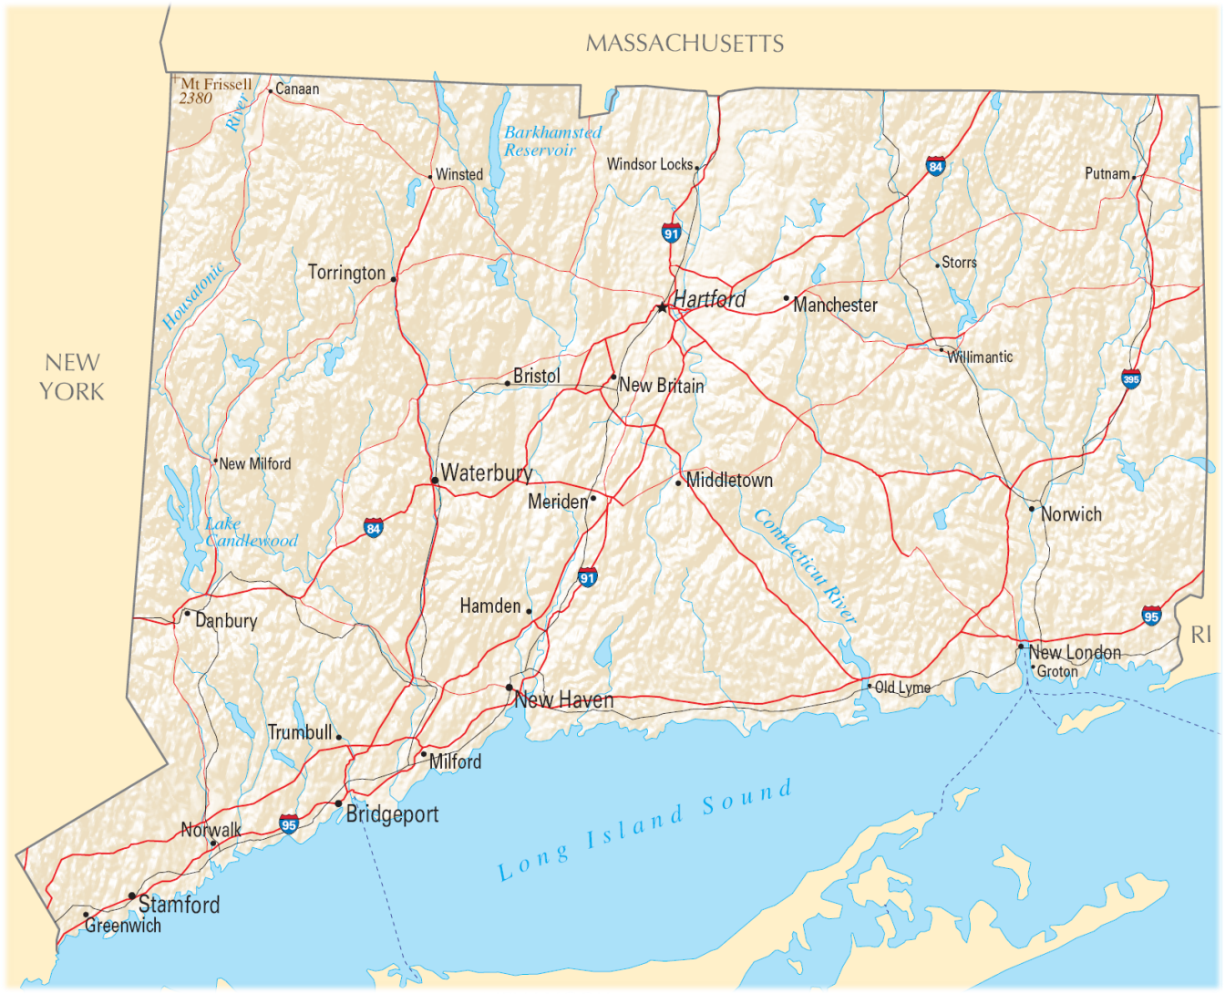
Connecticut – Algonquian for ‘Long River Valley’ (Site characteristic)

Slide 18
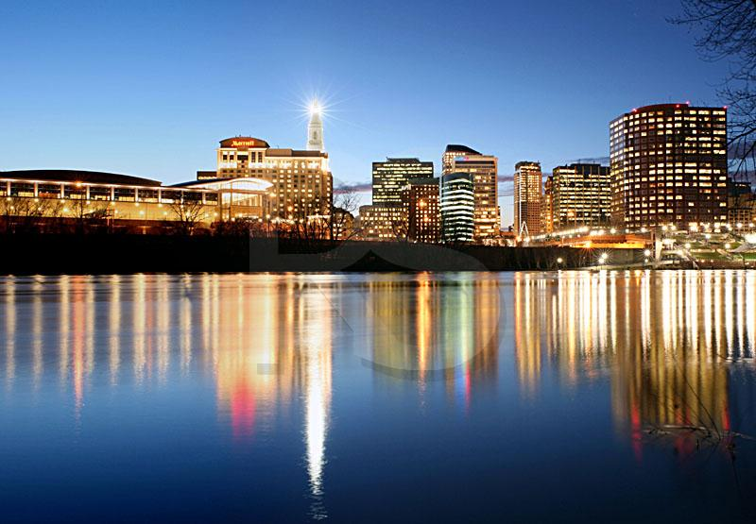
HARTFORD was called SUCKIAUG by Native Americans, meaning ‘Black fertile Earth, good for planting;’
It was later renamed by English colonists after Hertford in England.

Slide 19
Avon - Bolton - Bristol - Canterbury - Colchester - Colebrook - Cornwall - Coventry - Cheshire - Chester - Danbury Derby - Durham - Enfield - Essex - Glastonbury - Groton - Hartford - Kent - Litchfield - Manchester - New Britain - New London - Norwich - Portland - Preston - Stafford - Stamford - Stratford - Wallingford - Windsor
What do all of these CT toponyms have in common?

Slide 20
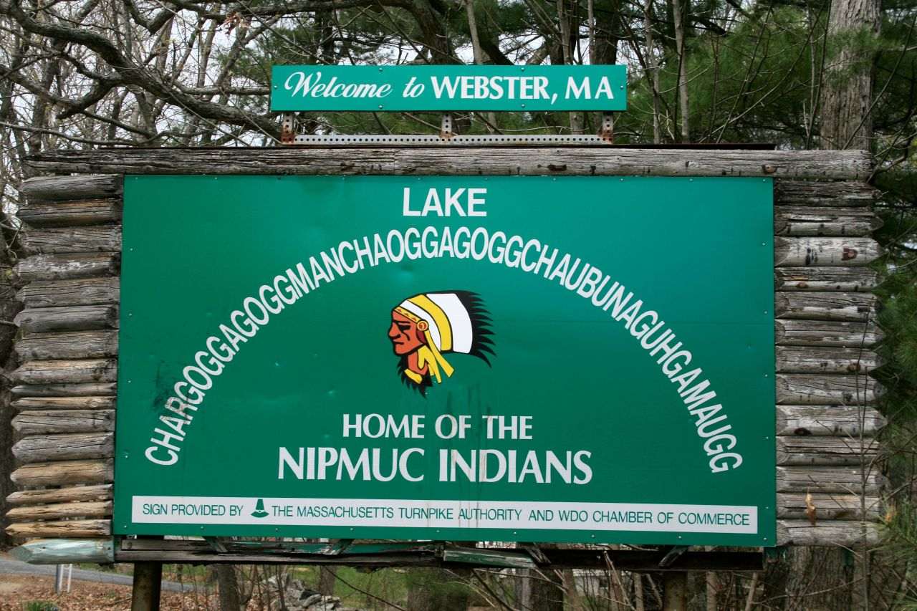
‘Fishing Place at Boundaries – Neutral Meeting Grounds’

Slide 21
LOCATION: SITE
SITE is the physical character of a specific place.
Site characteristics include climate, water sources, topography, soil, vegetation, latitude, & elevation.

Slide 22
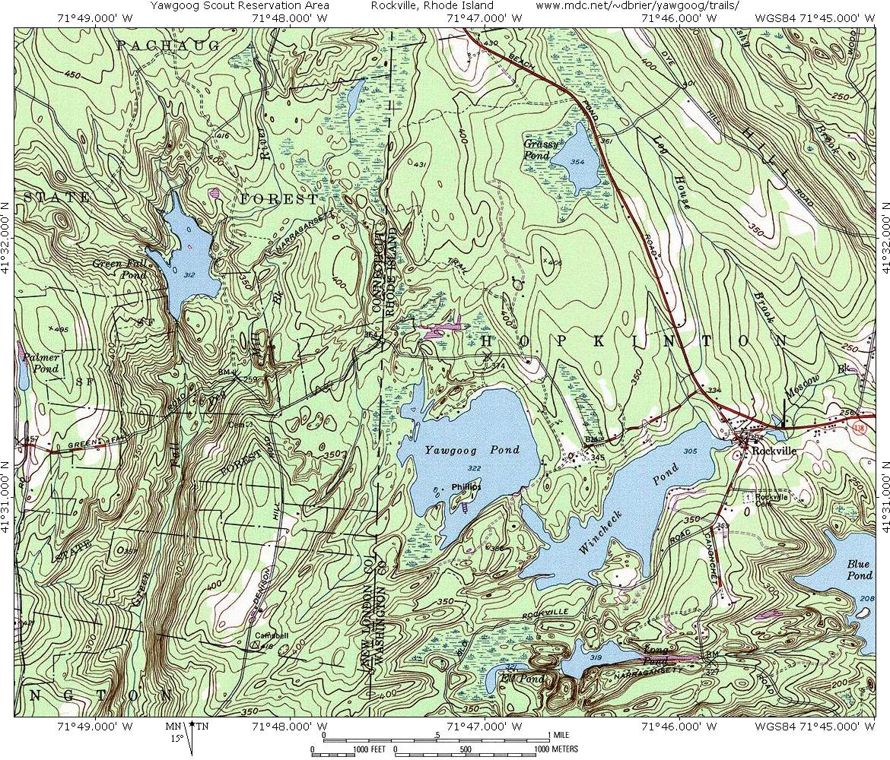
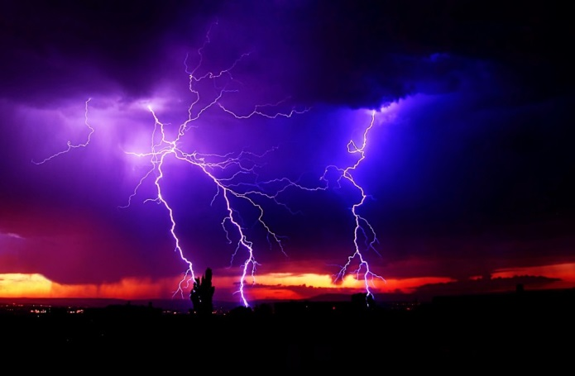
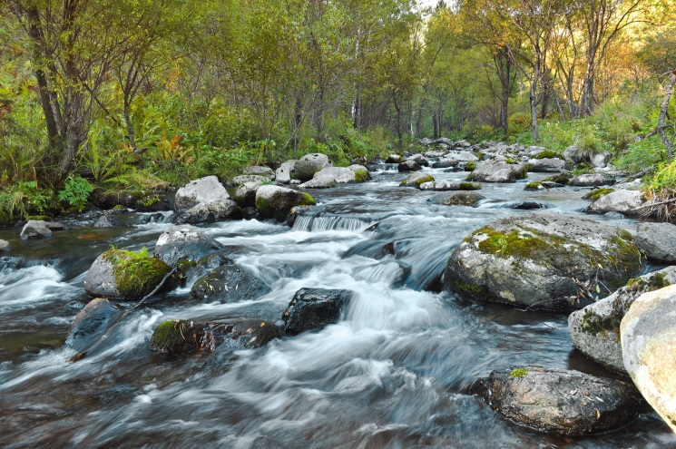
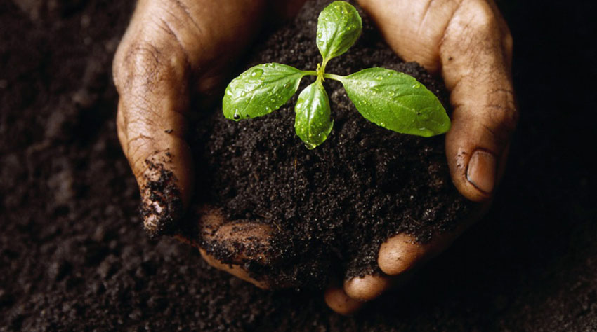
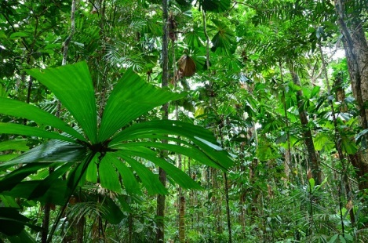
SITE

Slide 23
Humans can MODIFY a site (change its physical characteristics)

Slide 24
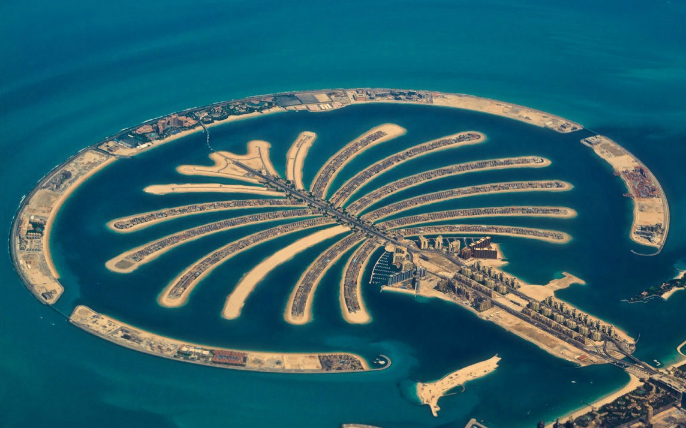
Palm Jumeirah- Artificial Island in Dubai

Slide 25
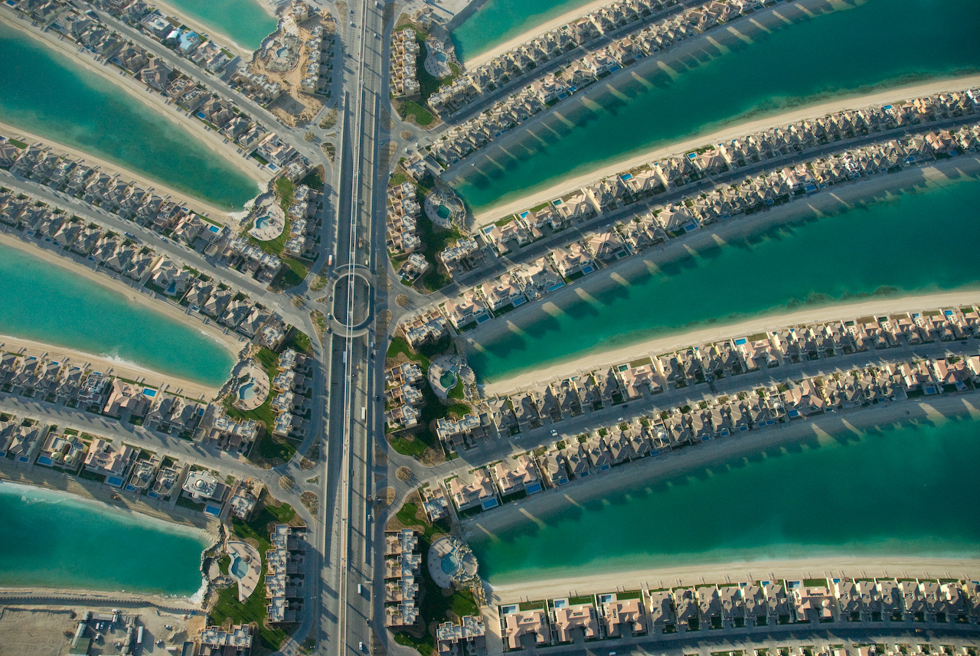

Slide 26
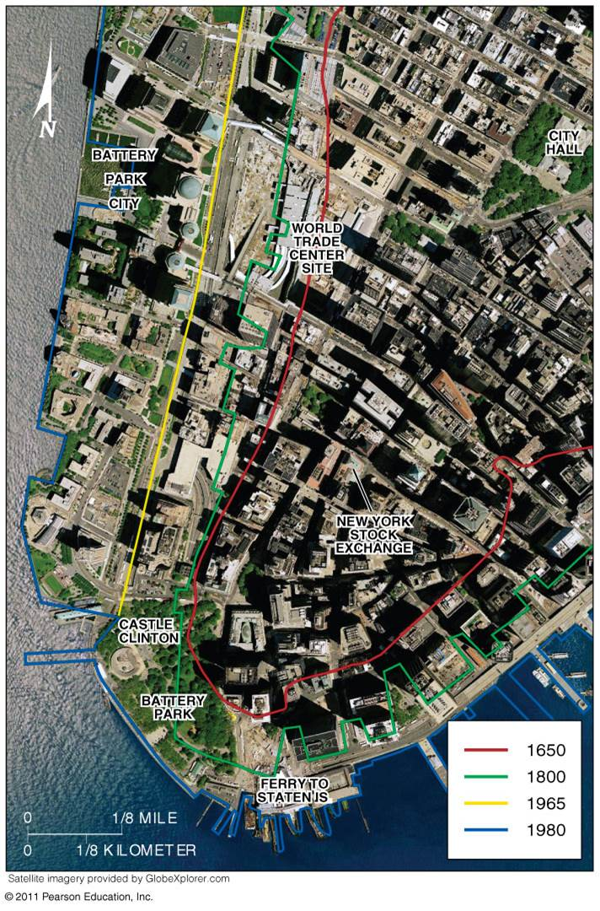
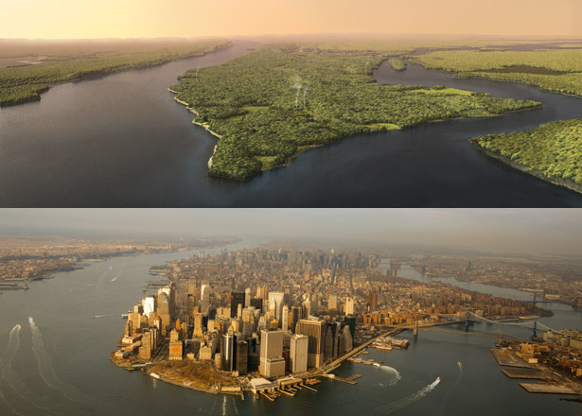

Slide 27
LOCATION: SITUATION
Situation is the location of a place relative to other places.

Slide 28
Often, examining SITUATION can reveal factors leading to the success of certain settlements.

Slide 29
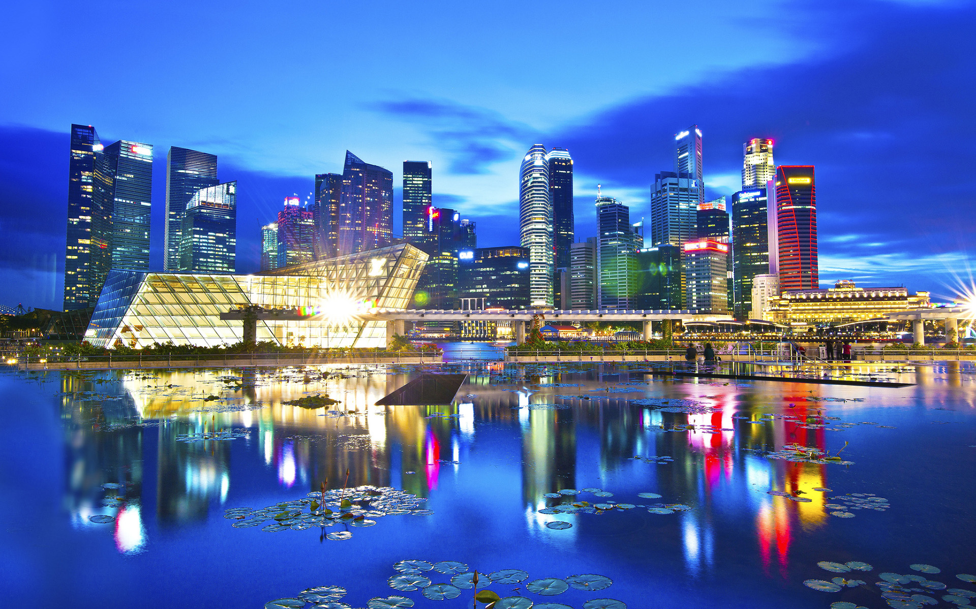
Singapore – Major World Shipping Hub

Slide 30
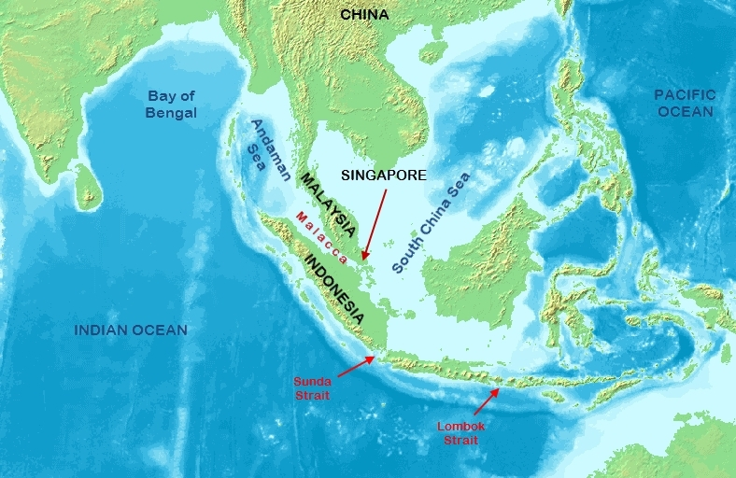
SINGAPORE - STRAIT OF MALACCA

Slide 31
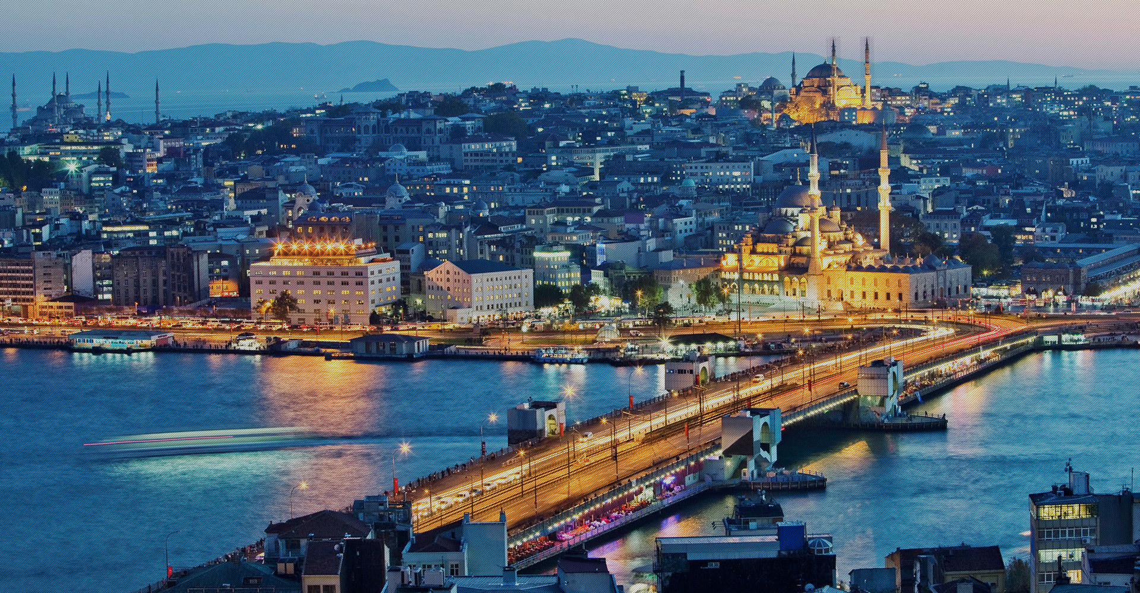
Istanbul, Turkey

Slide 32
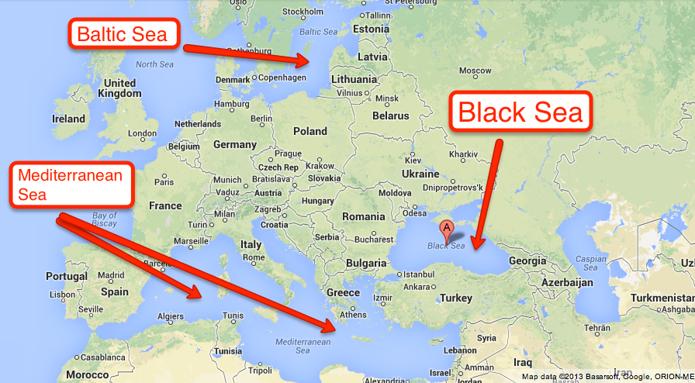
ISTANBUL - BOSPORUS

Slide 33
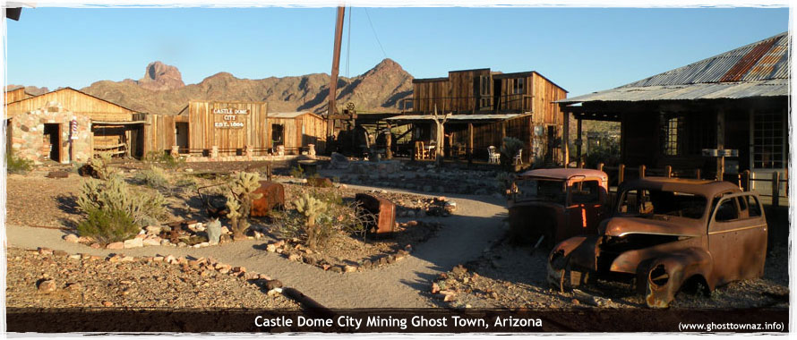
SITUATION, however, can also explain why some settlements are less prosperous.

Slide 34
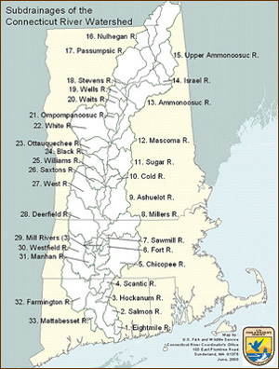
Old Saybrook is located at the mouth of the CT river; many major cities are located in similar SITUATIONS.

Slide 35
Old Saybrook would likely be a city if not for the SANDBAR off its coast that prevents ships from passing upriver

Slide 36
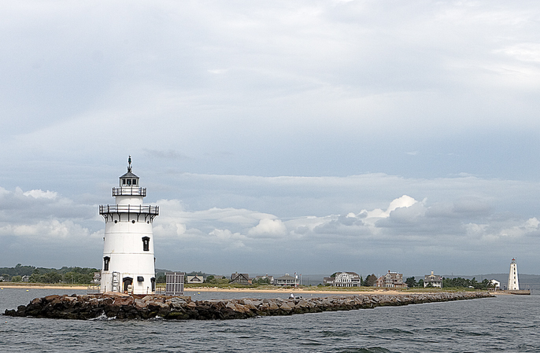
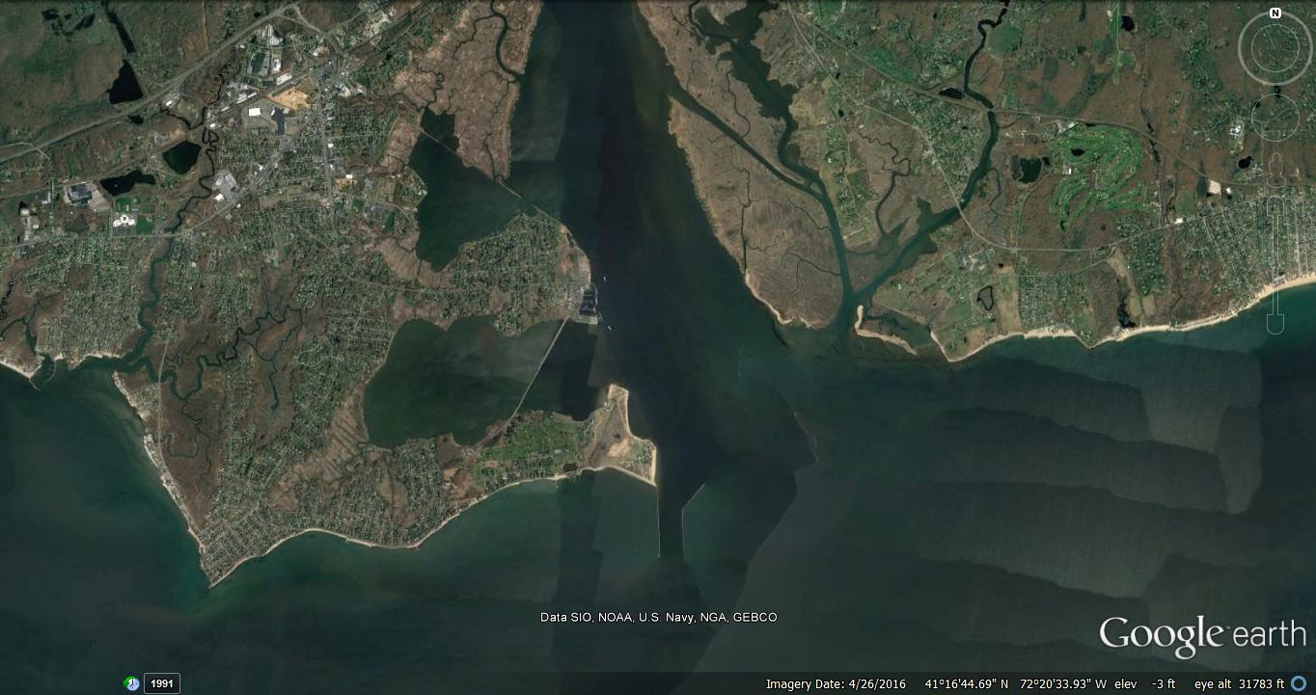
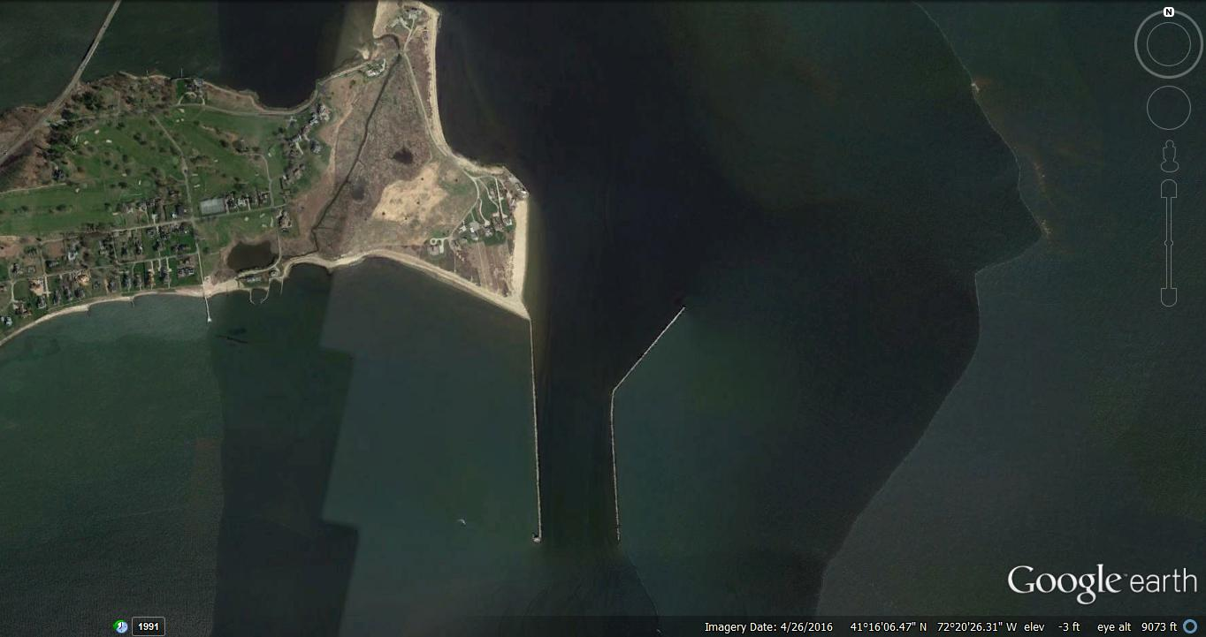

Slide 37
Aside from identifying LOCATION CHARACTERISTICS, geographers also look for SIMILARITIES which unite different PLACES together into groups.
These groupings are called REGIONS.

Slide 38
REGION: A Unique Area
An area on Earth defined by one or more distinctive characteristics is a REGION.
Usually viewed at two scales:
Spanning ACROSS political states
(‘Eastern Europe’)
Constrained WITHIN one political state. (‘New England’)

Slide 39
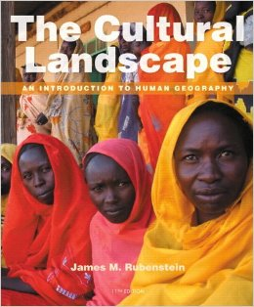
A region derives character through its CULTURAL LANDSCAPE- a combination of cultural, religious, economic, and physical features.

Slide 40
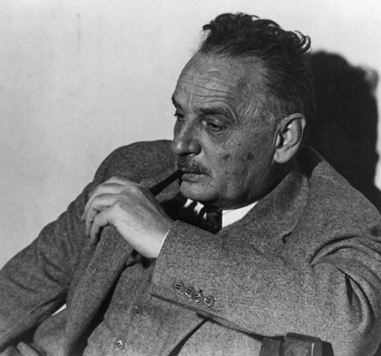
“Culture is the agent, the natural area the medium, and the cultural landscape is the result.” – Carl Sauer, American Geographer

Slide 41
Bethlehem, Palestine – Cultural landscape

Slide 42
Miami, FL – cultural landscape

Slide 43
Region: A Unique Area
Geographers identify three types of REGIONS.
1.) FORMAL Region (UNIFORM region)
An area in which (nearly) everyone shares one or more distinctive characteristics
Notes:
Montana is an example of a formal region.
The North American Wheat Belt is a formal region in which wheat is the most commonly grown crop, but other crops are grown there as well.

Slide 44
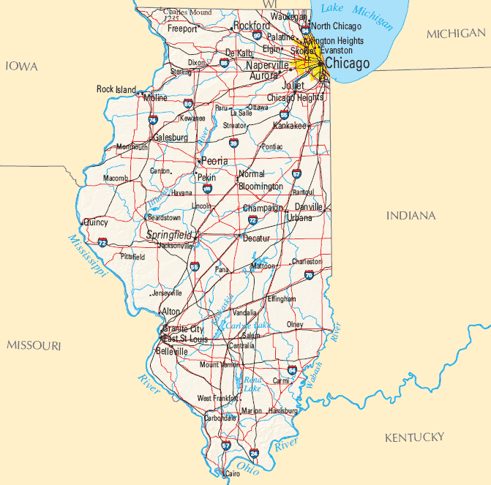
Formal Regions
Areas in which certain characteristics are found throughout the area
Formal Regions include countries, states, and cities; all share the same laws, government, etc.

Slide 45
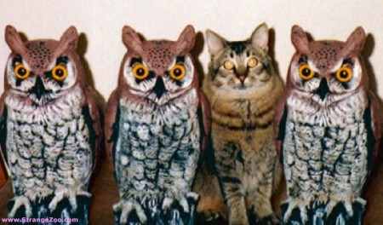
A characteristics defining a formal region does not have to be UNIVERSAL, only PREDOMINANT.
In other words not everyone/thing needs to follow suit, just MOST of them.

Slide 46
Formal regions can shift over time.
The regions where Republicans or Democrats hold sway changes over time, but the over all picture stays largely the same.
Notes:
Figure 1-17 FORMAL REGIONS The three maps show the winner by region in the (left) 2004, (center) 2008, and (right) 2012 presidential elections. The extensive areas of support for Democrats (blue) and Republicans (red) are examples of formal regions. (left) In 2004, Democrat John Kerry won most of the states in the Northeast, Upper Midwest, and Pacific Coast regions, while Republican George W. Bush won the remaining regions. (center) In 2008, Democrat Barack Obama won the election by capturing some states in regions that had been won entirely by the Republican four years earlier. (right) In 2012, Democrat Obama won reelection because he carried nearly the same states as four years earlier.

Slide 47
World Languages - Formal Regions
(Predominant, not universal)

Slide 48
REGION TYPES
2.) FUNCTIONAL Region (NODAL region)
An area organized around a node or central focal point
Common characteristic strong at central node and diminishes outward.
Notes:
Functional Region –
New technology is breaking down traditional functional regions, because the Internet and satellite dish television reach patrons farther and farther away from a central node.
Vernacular Region –
A useful way to identify perceptual regions is to get someone to draw a mental map, which is a internal representation of a portion of Earth’s surface, as one perceives it.

Slide 49
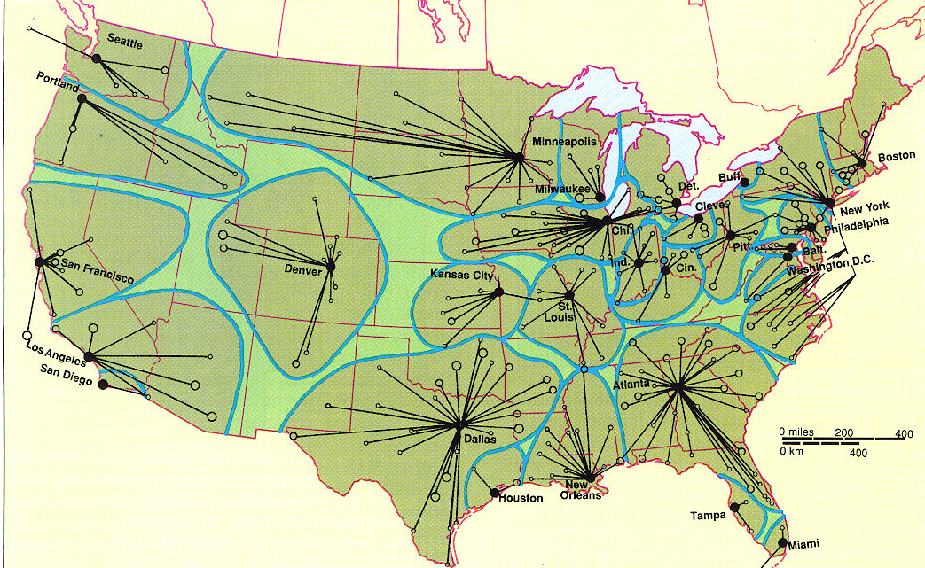
SMALL BANKS and their linkages to REGIONAL BANKING HUBS
(NODAL)

Slide 50
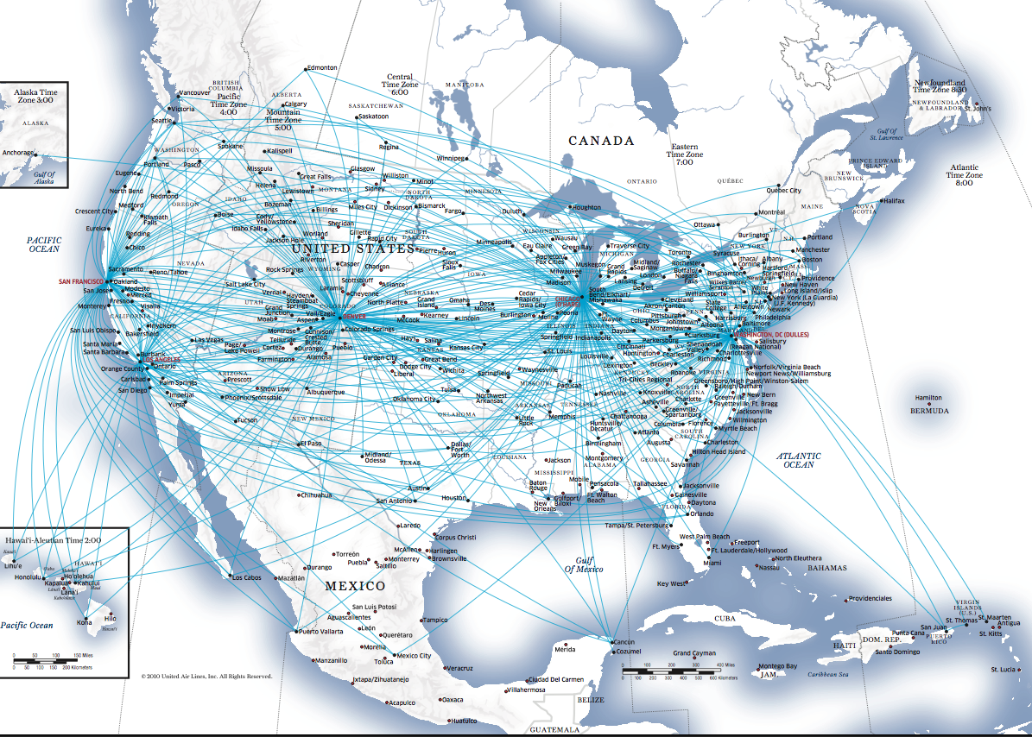
CONTINENTAL AIRLINES HUB MAP

Slide 51
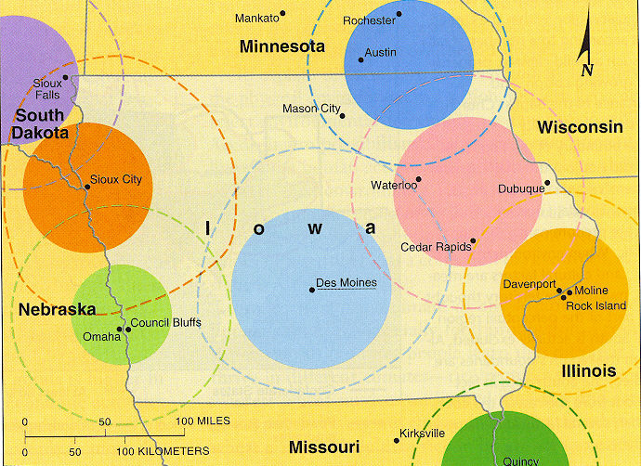
The state of Iowa is a FORMAL Region.
The broadcast areas of LOCAL TV STATIONS are FUNCTIONAL Regions (or Nodal Regions)

Slide 52
REGION TYPES
3.) VERNACULAR Region
(PERCEPTUAL region)
-
An area that people believe exists as part of their cultural identity.

Slide 53
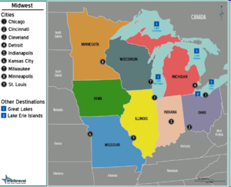
Perceptual Region = Area defined by people’s feelings and attitudes
Where is “The Midwest”?
Is NEBRASKA in the Midwest?
Is TEXAS in the Midwest?

Slide 54
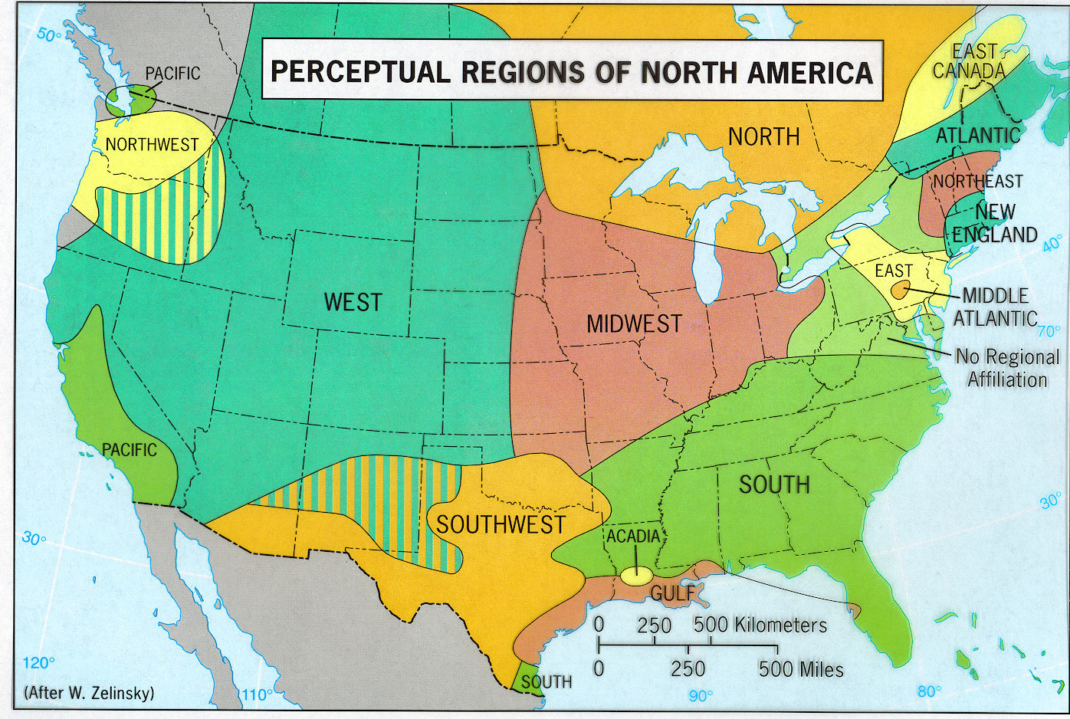
Notes:
The cultural geographer Wilbur Zelinsky studied the perceptual regions of North America-he identified 12 major regions. Notice that there is considerable overlap. Interviews or using phone books and noting when companies use the term southern or Dixie would indicate a perception of a region.

Slide 55
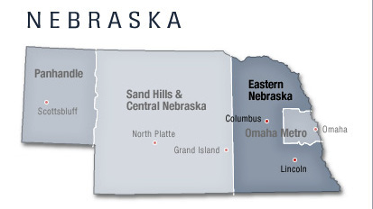
PERCEPTUAL regions can vary within a state- even within a town.

Slide 56
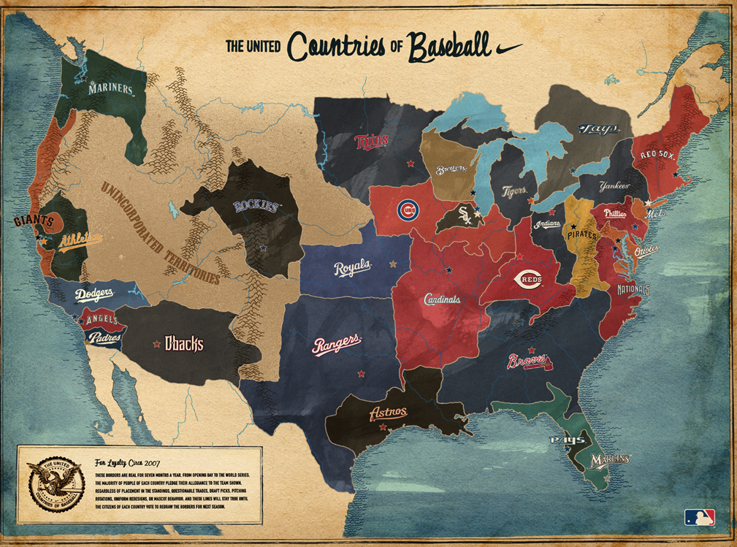

Slide 57
PERCEPTUAL REGIONS often overlap heavily with the CULTURAL LANDSCAPE and SENSE OF PLACE.
Are you from HARTFORD, or a part of it? SOUTH END, NORTH END, WEST END?
What is the DIFFERENCE between each to YOU? What do people from other areas think of YOUR part of the city?

Slide 58
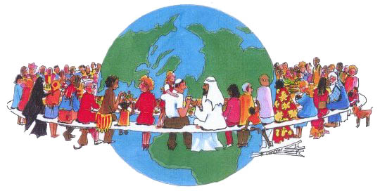
The final way in which an PLACE become distinctive is the CULTURE which predominates there.

Slide 59
CULTURE is what people CARE ABOUT, and this has TWO FORMS:
What we CARE ABOUT
Spiritual wealth -ideas, attitudes, beliefs, & values
What we TAKE CARE OF
Material wealth – food, clothing, shelter, & environment

